Slide 1

Healthcare Scenario: Healthy Living and Wellness Clustering Exercise
Created By: Harika Yenuga
Smita Karande
Amool Siri
Mavin Rodrigues
Sai Kumar

Slide 2
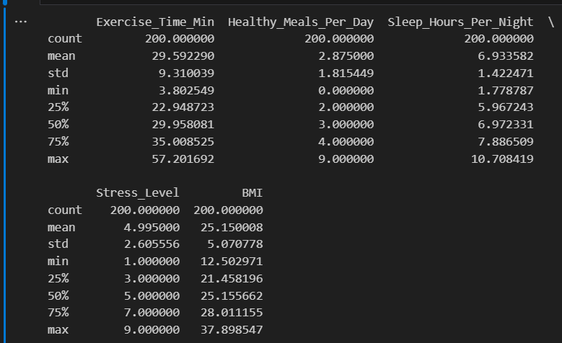
Exploratory Data Analysis (EDA)
generating summary statistics to understand the basic characteristics of the dataset.

Slide 3
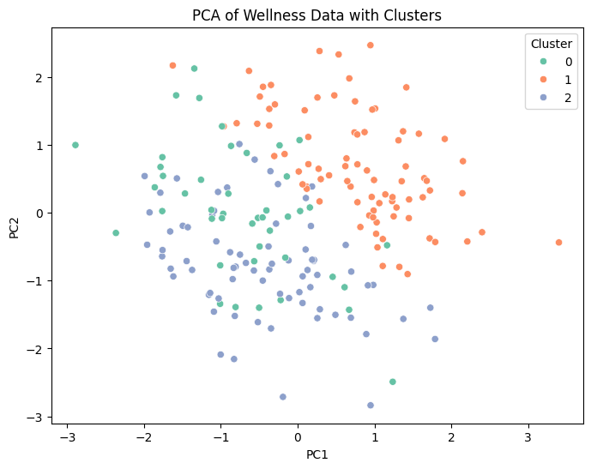
Principal Component Analysis (PCA)
Explained Variance by PCA Components:
PC1: 23.69%
PC2: 22.08%
Total Explained Variance: 45.77%
PCA Components (Loadings):
PC1: Significant loadings on Exercise Time, Healthy Meals, Stress Level, BMI
PC2: Significant loadings on Exercise Time, Stress Level
Visual: Include PCA Component Loadings table

Slide 4
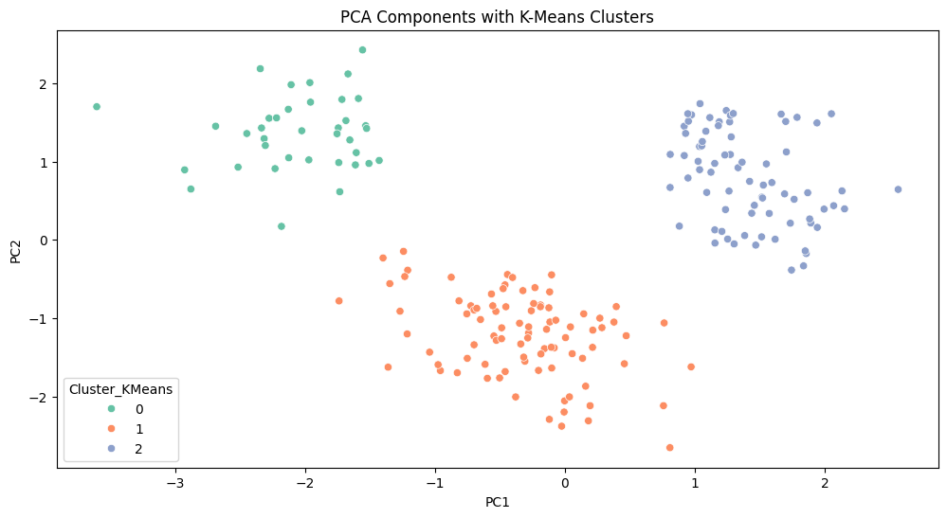
K-Means Clustering (Before PCA)
Silhouette Score: 0.15
Visualization: Scatter plot of Exercise_Time_Min vs. BMI with clusters
Visual: Include the scatter plot with cluster colors

Slide 5
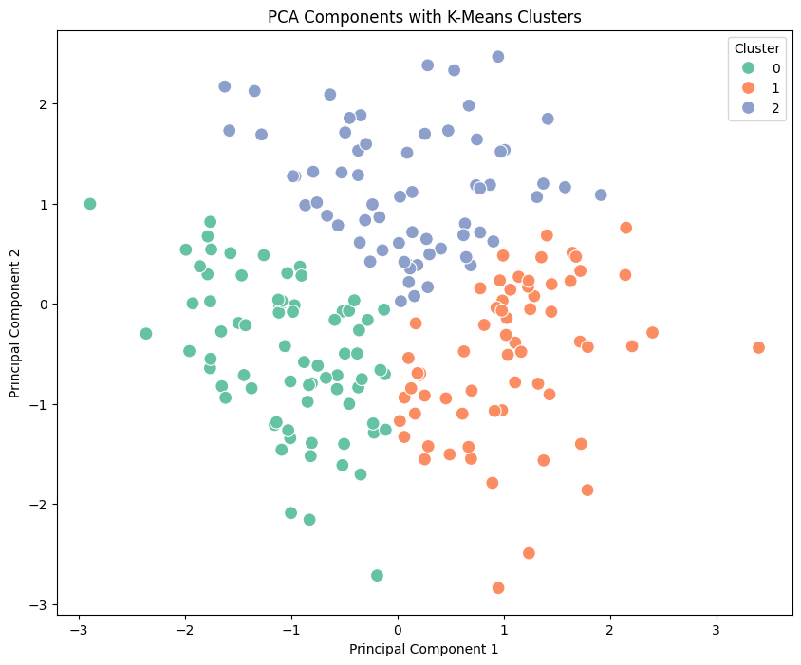
K-Means Clustering (After PCA)
Explained Variance Ratio: [0.23691549 0.22082517] Cumulative
Explained Variance: [0.23691549 0.45774066]
Silhouette Score for PCA-reduced K-Means: 0.3625606718282872 Within-Cluster Sum of Squares (Inertia) for PCA-reduced K-Means: 190.5881092579562
PCA Loadings: PC1 PC2 Exercise_Time_Min 0.343398 -0.478061
Healthy_Meals_Per_Day 0.395626 0.060977 Sleep_Hours_Per_Night -0.220185 0.687225 Stress_Level -0.530921 -0.543546
BMI 0.628649 0.004418

Slide 6
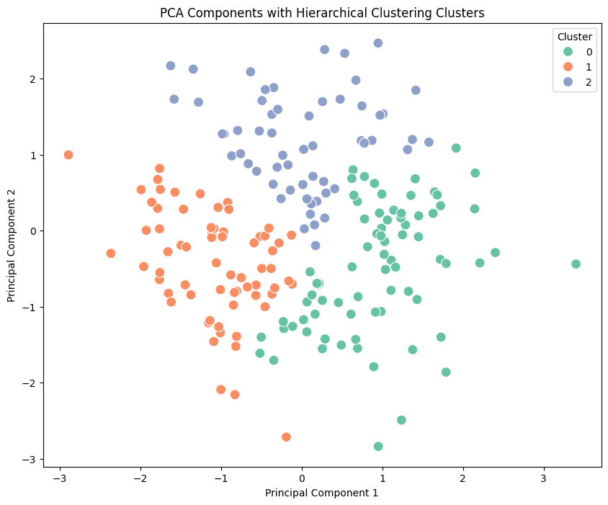
Hierarchical Clustering
Silhouette Score for Hierarchical Clustering (Before PCA) on Standardized Data: 0.13628495765267165
Explained Variance Ratio: [0.23691549 0.22082517]
Cumulative Explained Variance: [0.23691549 0.45774066]
Silhouette Score for PCA-reduced Hierarchical Clustering: 0.33440287604087543
PCA Loadings: PC1 PC2 Exercise_Time_Min 0.343398 -0.478061
Healthy_Meals_Per_Day 0.395626 0.060977 Sleep_Hours_Per_Night -0.220185 0.687225 Stress_Level -0.530921 -0.543546
BMI 0.628649 0.004418

Slide 7
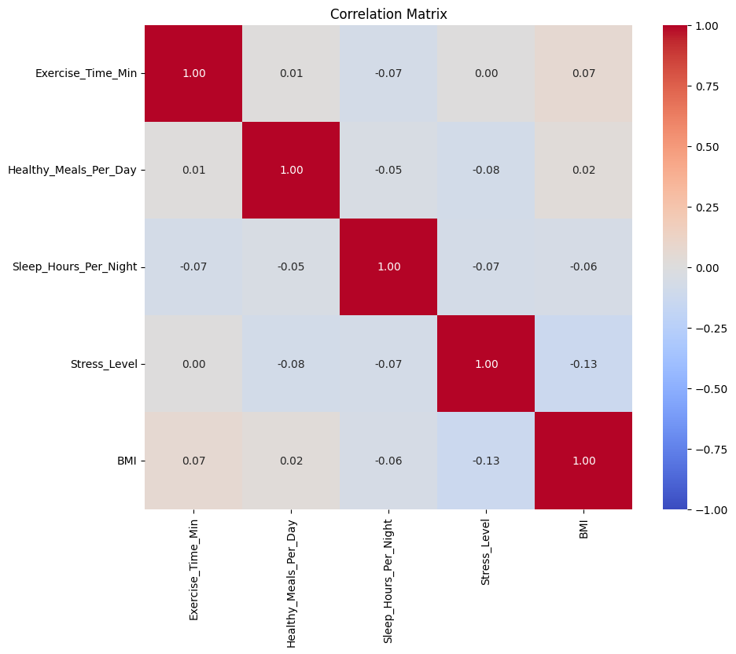
Examine how features correlate with each other.

Slide 8
Summary and Conclusion
EDA helps understand data distribution and feature relationships.
Hierarchical Clustering groups patients based on their health data, both before and after PCA.
PCA simplifies the data and helps in understanding clusters better.
Evaluation Metrics like the silhouette score measure the quality of clustering.

